Slide 1
Elite Interviews
Doing Political Research

Slide 2
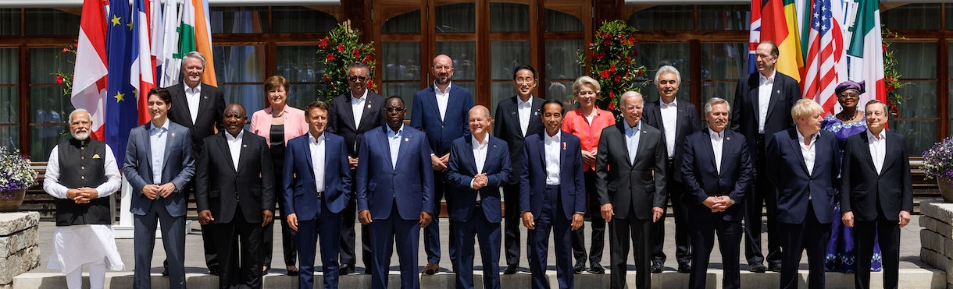
Who Are ‘Elites’?
No clear definition
Those occupying a privileged social, economic or political position who can provide insights into institutions, processes and events which are difficult to discover in other ways
Examples: elected politicians, senior government/NGO/IO officials, religious/community leaders
Specific issues to address different to interviewing ‘non-elite’ research participants

Slide 3
Why Interview Elites?
Corroborate what has been established from other sources
Establish what a set of leaders/senior officials think
Make inferences about a larger population's characteristics/decisions
Reconstruct an event or set of events

Slide 4

Three sets of ‘problems’ with elite interviews…
Practical problems: how do you get access to elites? How do you interview them?
Philosophical problems: how do you use them as a methodology? Empirical or interpretive? How might power relations affect the interview?
Analytical/presentational problems: how do you analyse interviews/present them as findings? How do you use information given on condition of anonymity?

Slide 5
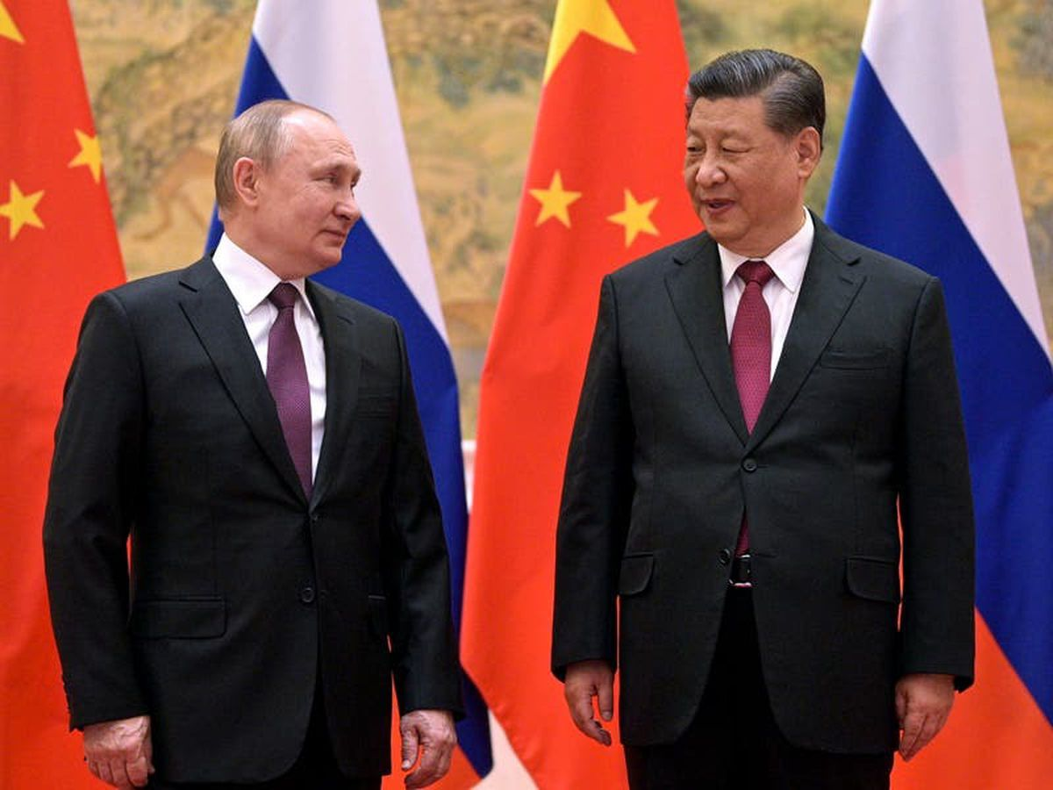
Practical problems: how do I get access to elites?

Slide 6

The Approach
Use status/institution?
Flattery
Use connections and snowball
Be clear about timing, questions and topic
Be honest on timing, questions and topic

Slide 7
How Do I Interview Them?
Planning: prepare, research and practice
Practicalities: recording or notes? time pressures
Psychology: read the interview, power relations

Slide 8
The Questions
How should they be shaped?
Follow up?
Open or closed?
How to begin or end?

Slide 9
Persistence
How will you respond to
Avoiding answering a question?
Suspicion?
Digression?
Listen to what is said and how it is said
Reverse the order-or abandon it
Prompt e.g. detail, elaborate/explain, return to a point

Slide 10

Philosophical Problems
Interpretive or narrative approach?
Facts or opinions?
Central to research or providing colour?
Triangulation with other methods?

Slide 11
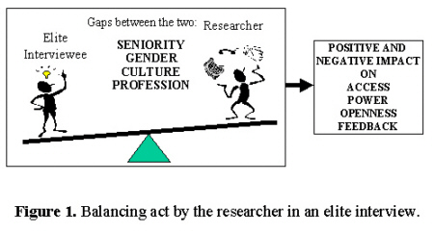
Power Relations?

Slide 12
Analytical Problems

Slide 13
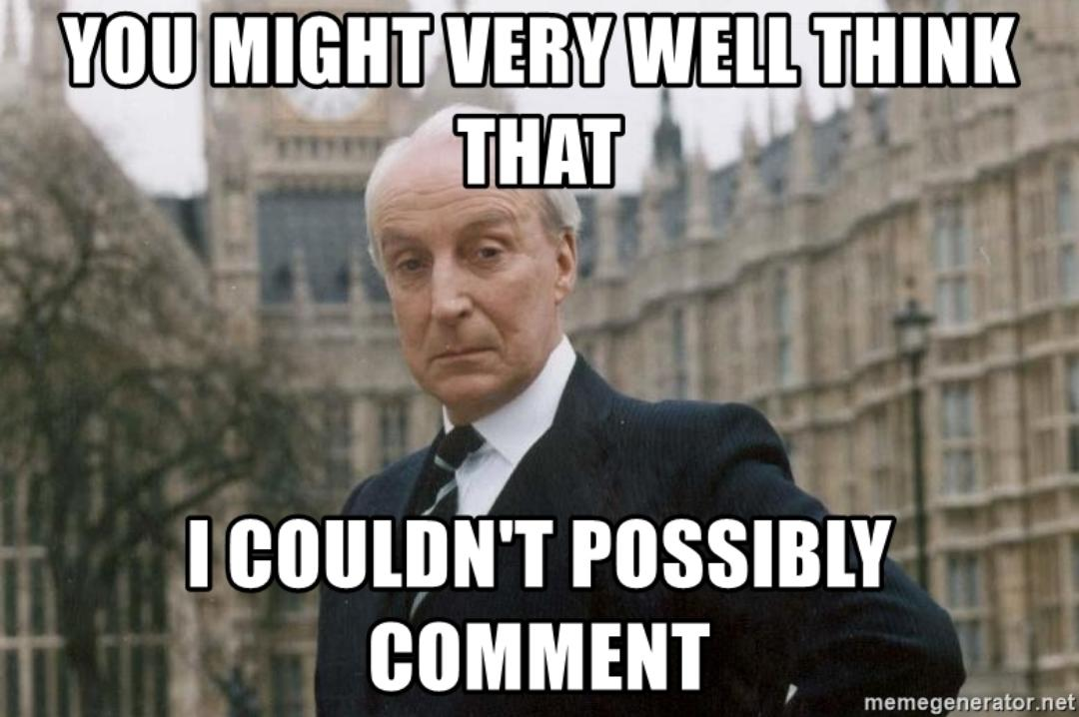
Anonymity? On/off the record?

Slide 14


The Suez conundrum (Lilleker)

Slide 15
Conclusion
Many methodological choices to make when interviewing: Who, where, how, positionality etc
Interviewing elites presents extra difficulties: practical, philosophical and analytical
But it is a very important method for researching certain questions
Vital to prepare well and reflect on how design and implementation might affect your findings

